Slide 1
Best place to live in California

Slide 2
Objective of the project
Help in locating the best place live in the Golden State based on income and available schools

Slide 3
Getting data for the project
APIs:
GreatSchools.org
US Census
American FactFinder

Slide 4
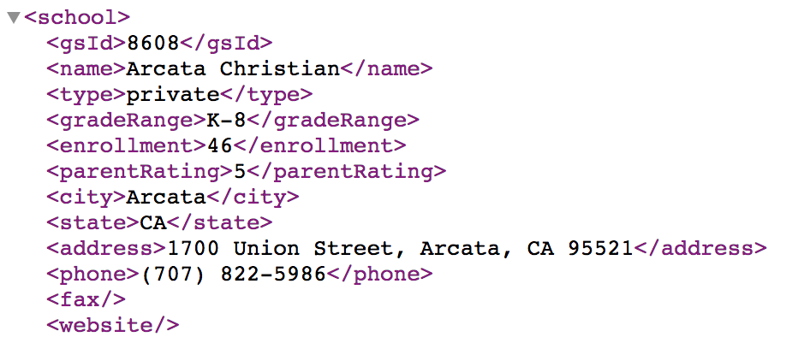
Creating database
Web scrapping GreatSchool website by city names
Use MongoDB to process the school data
Convert MongoDB output to CSV and JSON file
Re-use squlite database to run python apps

Slide 5
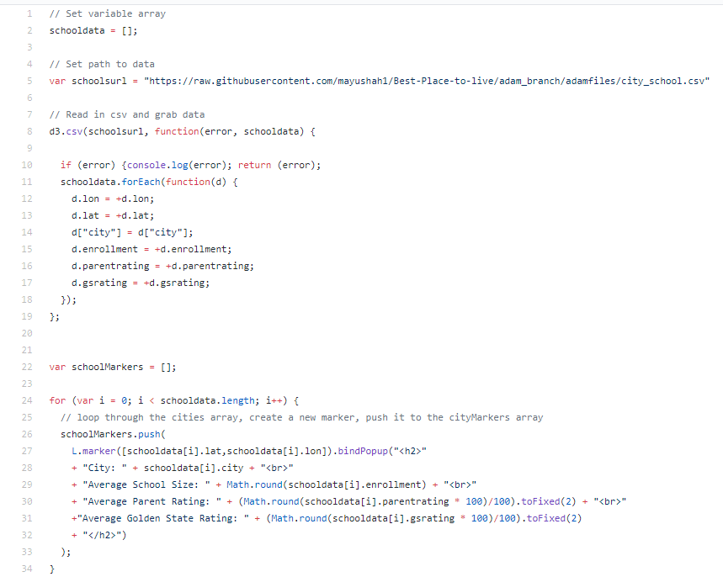
Creating Leaflet Map
Challenges:
Pulling csv data into js
Changing the format of the data, so it can be mapped
Lessons learned:
D3 can be used to read csv or json files even if you are not using D3 as your visualization tool
d. and d[] can be used to bring in data as float or string
.toFixed() and Math.round() can be used to change the number of decimal places of a specific variable

Slide 6
website
Add link

